Slide 1
Our Lady of Lourdes Reception parents/carers RWInc phonics presentation
Wednesday 27th September 2023

Slide 2
Our aims today from this presentation
Introduce the way we teach phonics, reading and writing in school.
Share strategies to support you at home with your child’s reading development.

Slide 4
What are we doing at Our Lady of Lourdes?

Slide 5
What is Read Write Inc. Phonics?
Read Write Inc. is a government backed phonics scheme designed by Ruth Miskin, which through systematic teaching and consistent routines, enables children to achieve high levels of reading success.
At Our Lady of Lourdes Catholic Primary School, we believe that reading is the key to all learning, and we are fully committed to making sure that every child is a reader by the end of KS1 (Year 2).

Slide 6
Our approach
We have introduced Read Write Inc. which is a complete systematic and structured literacy programme.
Meets the demands of the new national curriculum, giving your children the best chance of success.

Slide 7
How does it work? Starting at the beginning...Early Years Read storybooks and non-fiction books closely matched to their developing phonic knowledge Read with fluency and expression Learn to spell using known sounds Write confidently by practising what they want to write out loud first Work well with a partner

Slide 8
How does it work?
Aim at the end of Year 1...
Children are accurate and speedy readers and are ready to move onto class English lessons
One-to-one tutoring - no child is left behind.
Reading books align with the sounds learnt in class.

Slide 9
Who is Read Write Inc. phonics for?

Slide 10
Read Write Inc. Phonics
• EYFS – Y1/ Y2 (KS1)
• Older children who need to ‘catch-up’
• Children new to English

Slide 11
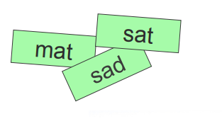
Systematic approach

Slide 12
What is systematic phonics?

Slide 13
Phonics
Sounds
Graphemes
English alphabetic code – one of the most complex in the world.
26 letters in the alphabet
44 phonemes (sounds)
Over 150+ graphemes

Slide 14
Language

Slide 15
How does Read Write Inc. use phonics to teach reading?

Slide 16
Speed Sounds Chart
Special friends: 2 sounds that make 1 sound.

Slide 17
Simple speed sounds

Slide 18
How will my child learn to read?
Children are taught the early sounds in Set 1. This covers the alphabet and a few ‘special friends’ which are two letters which make one sound such as ‘sh’. They will learn to spot and recognise them quickly through fun activities and also to write them using ‘phrases’ to help them remember the correct formation. We teach children ‘pure sounds.’
Pure sounds video link:
https://www.youtube.com/watch?v=TkXcabDUg7Q

Slide 19
Blending using Fred Talk Using these simple sounds, children will learn to ‘blend’ words together, so c-a-t becomes cat. To help the children do this, we have a lovely green frog called Fred! He can only talk in sounds, so the children put the sounds together to make the word. We call this ‘Fred Talk’.

Slide 20
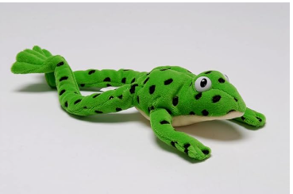
Fred talk
Fred Frog can only say the sounds in a word and needs your child to help him read the word. Fred will say the sounds and children will work out the word. For example, Fred will say the sounds c–a–t, and children will say the word cat. This is Fred Talk: sounding out the word.

Slide 21
Blending using Fred talk
Green words contain all the sounds we know
Fred talk with dots and dashes
Fred in your head
No Fred talk – speedy reading
When faced with an unfamiliar word we use the phrase ‘Special friends – Fred talk – Read the word’ as this reminds them that it is important to spot the special friends before attempting to read the word.

Slide 22
Alien words
To further consolidate this, we also use ‘Alien Words’ which are made up words that do not make sense.
These words test to see if the children can spot any special friends and that they have good sound knowledge, rather than recognising familiar (or sense) words and using memory rather than reading skills.
This technique is also used in the National Year 1 Phonics Check.

Slide 23
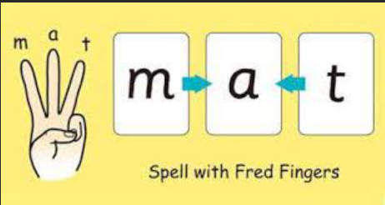
Fred Fingers
Similarly, Fred talk this supports early writing skills as children use ‘Fred Fingers’ to break down a spoken word into its sounds to enable them to write the word. We use the phrase ‘Say the word – pinch the sounds’ to help children remember.

Slide 24
After set 1
When they are confident with blending and know all of their Set 1 sounds, the children will move onto Set 2 sounds and then Set 3 sounds, which introduce alternative spellings for sounds they know and more special friends. They may begin to use ‘Fred in their head’ to read more quickly and fluently, which helps to build up speed, however this stage is also tricky for children as they need to be able to spot ‘special friends’ easily within new words.

Slide 25
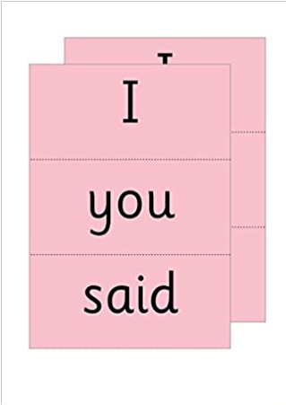
Red ‘tricky’ words
Words which can be decoded are called ‘Green Words’ as they can be deciphered using phonics knowledge.
Unfortunately, there are lots of words in the English language that do not follow these rules … they are called ‘Red Words’ or tricky words and need to be learned by sight.
We use the phrase ‘If it’s red - it’s hard to Fred’ to remind children.

Slide 26
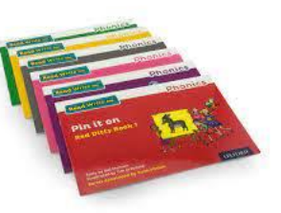
By moving through the carefully designed stages (or colours) of reading books which consolidate the sounds learned at the right time, children will gain speed and confidence in their reading ability.
As reading becomes more fluent, children begin to understand the stories they read and can enjoy the books. As part of the RWI sessions they will read their group books a total of three times; to support learning new speedy green words and more tricky red words, to investigate vocabulary.
They will also complete comprehension activities as part of each book to ensure they know word meanings and can find and retrieve information as well as give opinions about the story or link to other books they know or life experiences and to build expression known as their storyteller voice’.

Slide 27
Assessments
Stage not age – children are grouped based on their reading level and will be regrouped regularly.
Children are taught in groups according to their reading ability and so your child may be in a group with younger or older children. This will enable us to teach your child more effectively; children do not struggle because the work is too difficult or get bored because the work is too easy. They will access 100% of every lesson
Diagnostic assessments are carried out by the reading leader half termly for each child individually every 6-8 weeks. Any individual concerns are raised with the class teacher and senior leadership.
The assessments are used to inform groupings.

Slide 28
Reading books to take home
Once confident in blending, children will begin to receive two RWI books. These books will be read three times in their RWI phonics group.
These books allow children to apply their reading skills and are matched to the sounds they have been taught so far. These books should be read at home three times before being returned to school.
In the first read your child will be focussing on reading each word individually and it may seem robotic. In this phase very little comprehension of the story is likely.
In the second read, their word recognition will become quicker allowing a faster pace and better understanding of the story. In the third read, the speed should be much quicker and therefore the child is using more brain power to understand the story rather than on reading each word. This is the point when the story becomes meaningful and pleasurable, and they can answer questions based on the content. There are questions at the end of the book to check understanding and promote discussion of the story. Please take the time to complete these activities as there are the early comprehension skills which are built upon throughout school

Slide 29
How can I help at home?
It is recommended that all reading should take place in a calm and quiet environment, a story before bed time or snuggled on the sofa without distractions of the TV etc so the focus can purely be on the reading enjoyment. It should be relaxed and enjoyable and lots of praise should be given when children are successful. Please try not to get frustrated if your child is struggling as this likely to put them off trying, instead encourage them to sound out words using Fred Talk and help them to blend and then praise for being successful.

Slide 30
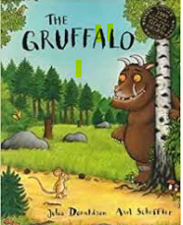
How can I support my child with reading?
Whilst your child is learning their Set 1 sounds, we recommend you only read their ‘Reading for Pleasure’ library books. This is a book that they are interested in and have chosen to enjoy with you. They can look at the pictures and spot letters or sounds that they know to build confidence but most importantly they should hear you read the book with expression in order to absorb the rich language and vocabulary within in and learn to love story time.

Slide 31
Helping at home
Don’t forget that even if your child can read RWI books it is still important for them to regularly hear you read in order to learn expression. This will remove some of the pressure on them and also helps to improve their vocabulary levels as the books they listen to can be for any age. They will still be bringing home a library book of their choice so make sure to include this in the weekly routine if you can.
Audio books are also helpful and can be a good technique for settling and relaxing children before bed or as part of longer car journeys.

Slide 32
How can I support at home?
Watch the phonics links sent home via Ping on reading, writing and blending.
Help your child to practise forming the letters correctly using the ditty to support. Handwriting sheets sent home daily once the letter sound has been taught.
If your child is uncomfortable to write with a pencil DO NOT FORCE THEM. There are many ways to build up their fine motor skills:
Large brushes and water- paint on the pavement/chalkboard
Form letters in shaving foam/ rice/ glitter trays/sand
Write in the air/ on each others backs.

Slide 33
The main resource you can provide your child with are time, patience and praise, and together we will make sure they are confident readers
https://home.oxfordowl.co.uk/reading/reading-schemes-oxford-levels/read-write-inc-phonics-guide/

